Slide 1
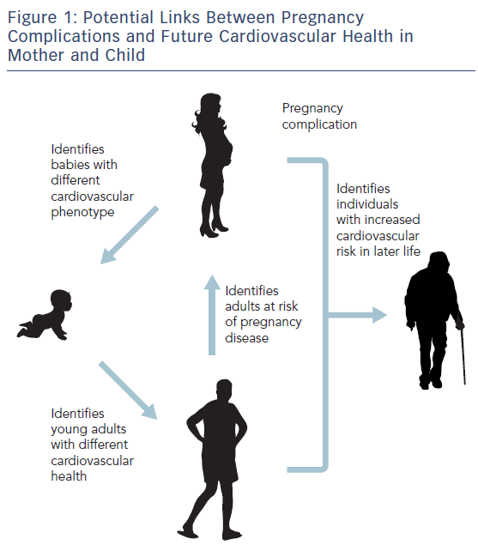
Aye CY, Boardman H, Leeson P
Figure 1: Potential Links Between Pregnancy Complications and Future Cardiovascular Health in Mother and Child
Citation: European Cardiology Review 2017;12(1):20–3.
https://doi.org/10.15420/ecr.2017:4:1

