Slide 1
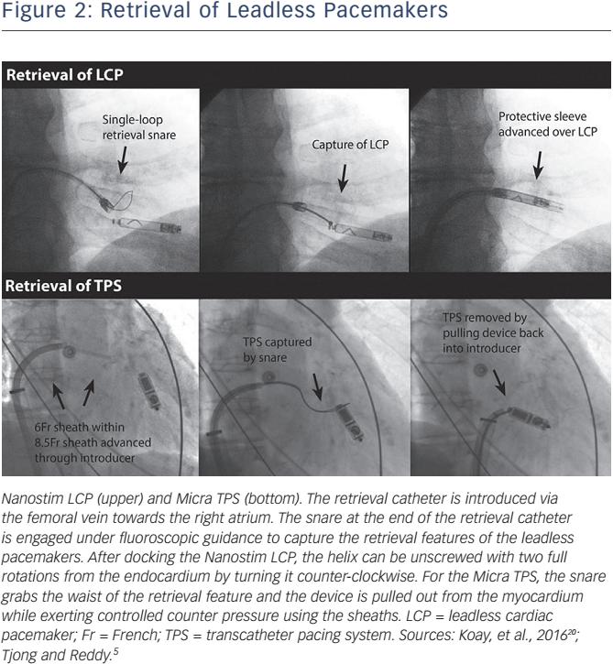
Beurskens NE, Tjong FV, Knops R
Retrieval of Leadless Pacemakers
Citation: Arrhythmia & Electrophysiology Review 2017;6(3):129–33
https://doi.org/10.15420/aer.2017:16:1

