Slide 1
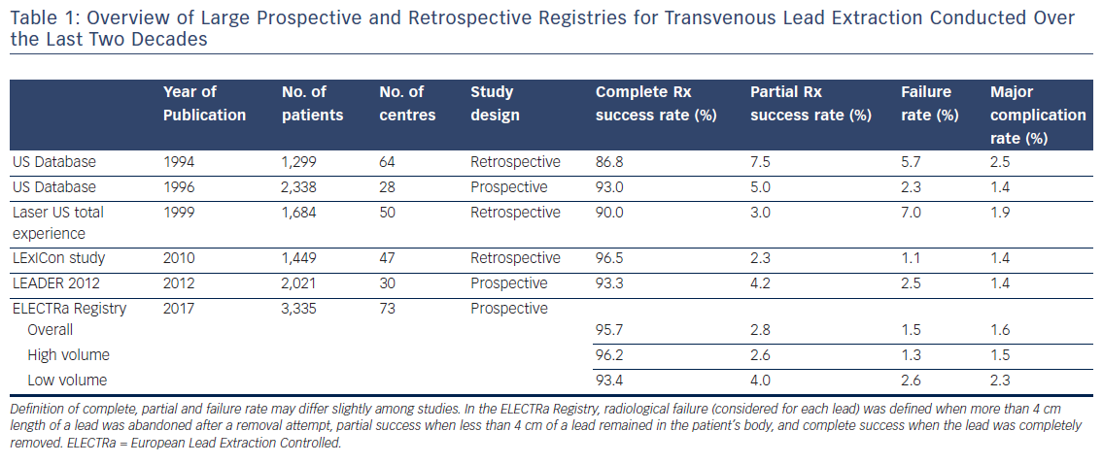
Auricchio A, Regoli F, Conte G, Luce Caputo M
Table 1: Overview of Large Prospective and Retrospective Registries for Transvenous Lead Extraction Conducted Over the Last Two Decades
Citation: Arrhythmia & Electrophysiology Review 2017;6(3):111–3.
https://doi.org/10.15420/aer.2017.25.1

