Slide 1
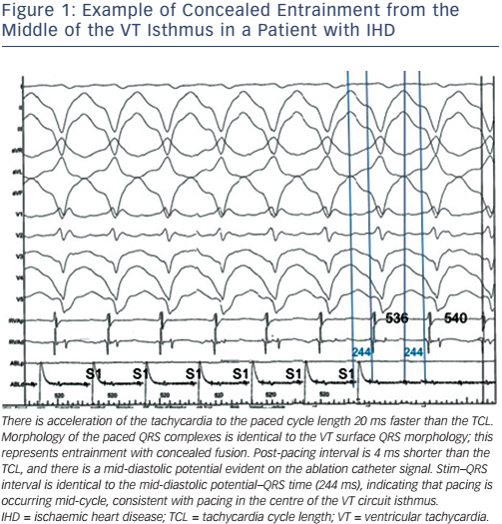
Graham AJ, Orini M, Lambiase PD
Example of Concealed Entrainment from the Middle of the VT Isthmus in a Patient with IHD
Citation: Arrhythmia & Electrophysiology Review 2017;6(3):118–24
https://doi.org/10.15420/aer.2017.20.1

