Slide 1
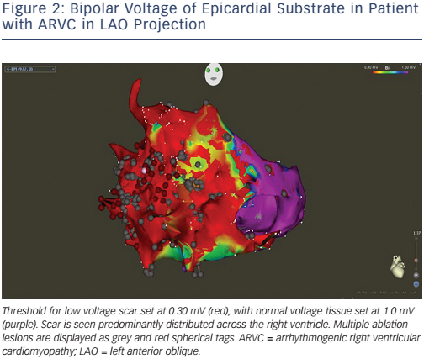
Graham AJ, Orini M, Lambiase PD
Bipolar Voltage of Epicardial Substrate in Patient with ARVC in LAO Projection
Citation: Arrhythmia & Electrophysiology Review 2017;6(3):118–24
https://doi.org/10.15420/aer.2017.20.1

