Slide 1
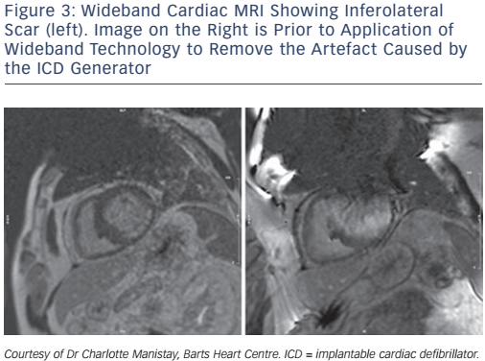
Graham AJ, Orini M, Lambiase PD
Wideband Cardiac MRI Showing Inferolateral Scar (left). Image on the Right is Prior to Application of Wideband Technology to Remove the Artefact Caused by the ICD Generator
Citation: Arrhythmia & Electrophysiology Review 2017;6(3):118–24
https://doi.org/10.15420/aer.2017.20.1

