Slide 1
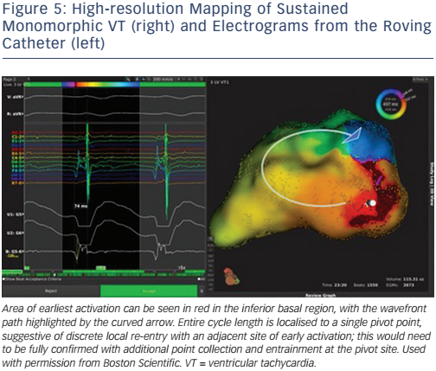
Graham AJ, Orini M, Lambiase PD
High-resolution Mapping of Sustained Monomorphic VT (right) and Electrograms from the Roving Catheter
Citation: Arrhythmia & Electrophysiology Review 2017;6(3):118–24
https://doi.org/10.15420/aer.2017.20.1

