Slide 1
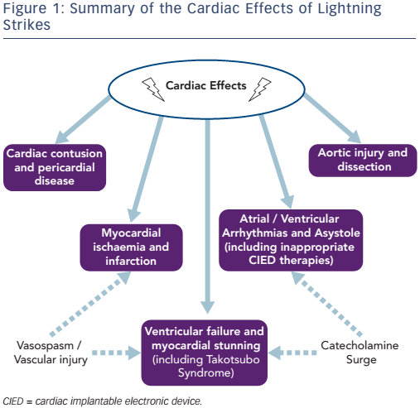
Christophides T, Khan S, Ahmad M, Fayed H, Bogle R
Summary of the Cardiac Effects of Lightning Strikes
Citation: Arrhythmia & Electrophysiology Review 2017;6(3):114–7
https://doi.org/10.15420/aer.2017:7:3

