Slide 1

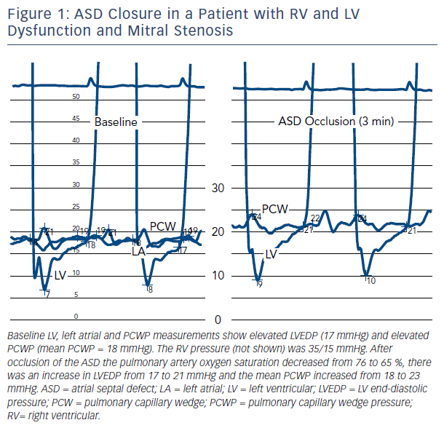
Shah SR, Waxman S, Gaasch WH
The Impact of an Atrial Septal Defect on Hemodynamics in Patients With Heart Failure
Citation: US Cardiology Review 2017;11(2):72–4.
https://doi.org/10.15420/ucs.2017:9:2

