Slide 1
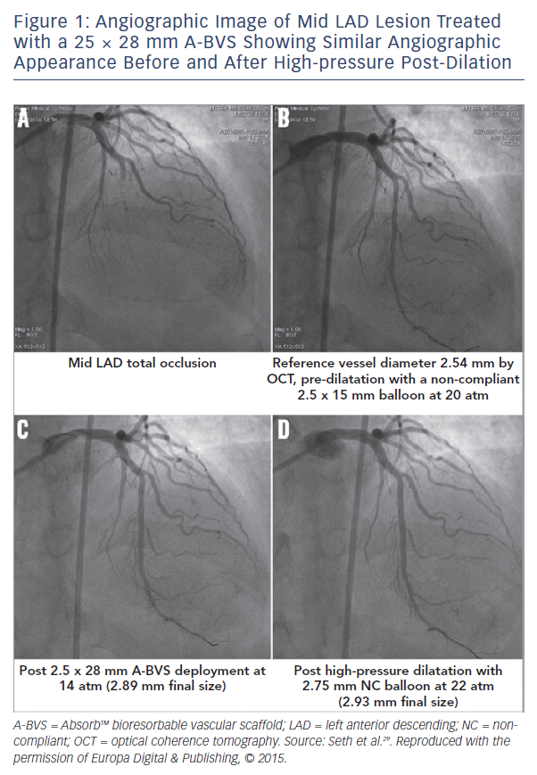
Seth A, Gupta S, Singh VP, Kumar V
Figure 1: Angiographic Image of Mid LAD Lesion
Citation: Interventional Cardiology Review 2017;12(2):81–4.
https://doi.org/10.15420/icr.2017:12:1

