Slide 1
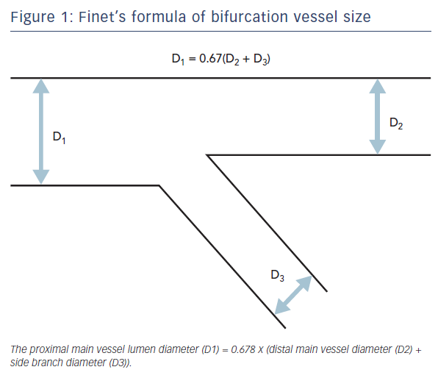
Hoye A
Figure 1: Finet’s formula of bifurcation vessel size
Citation: Interventional Cardiology Review 2017;12(2):110–5.
https://doi.org/10.15420/icr.2017:11:2

