Slide 1
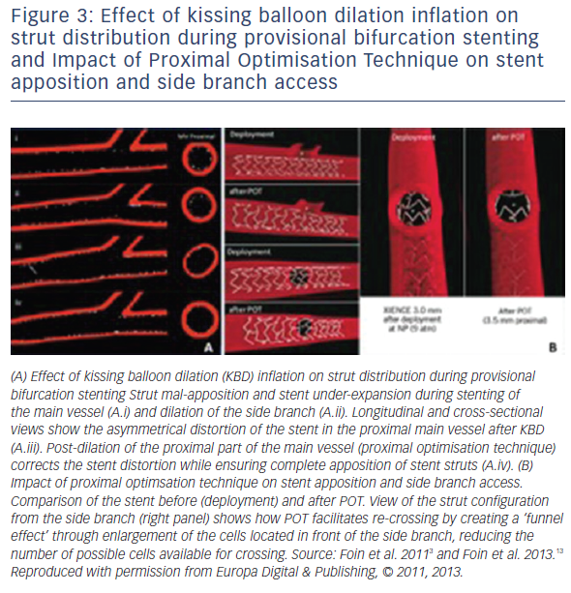
Hoye A
Figure 3: Effect of kissing balloon dilation inflation on strut distribution during provisional bifurcation stenting and Impact of Proximal Optimisation Technique on stent apposition and side branch access
Citation: Interventional Cardiology Review 2017;12(2):110–5.
https://doi.org/10.15420/icr.2017:11:2

