Slide 1
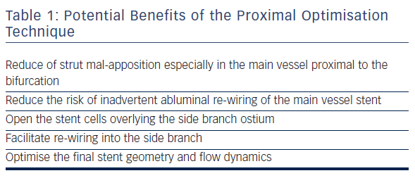
Hoye A
Table 1: Potential Benefits of the Proximal Optimisation Technique
Citation: Interventional Cardiology Review 2017;12(2):110–5.
https://doi.org/10.15420/icr.2017:11:2

