Slide 1
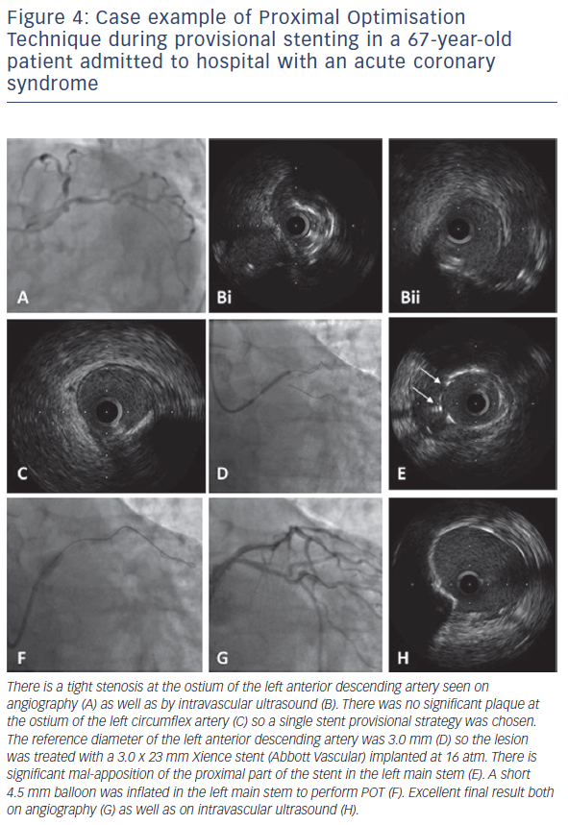
Hoye A
Figure 4: Case example of Proximal Optimisation Technique during provisional stenting in a 67-year-old patient admitted to hospital with an acute coronary syndrome
Citation: Interventional Cardiology Review 2017;12(2):110–5.
https://doi.org/10.15420/icr.2017:11:2

