Slide 1
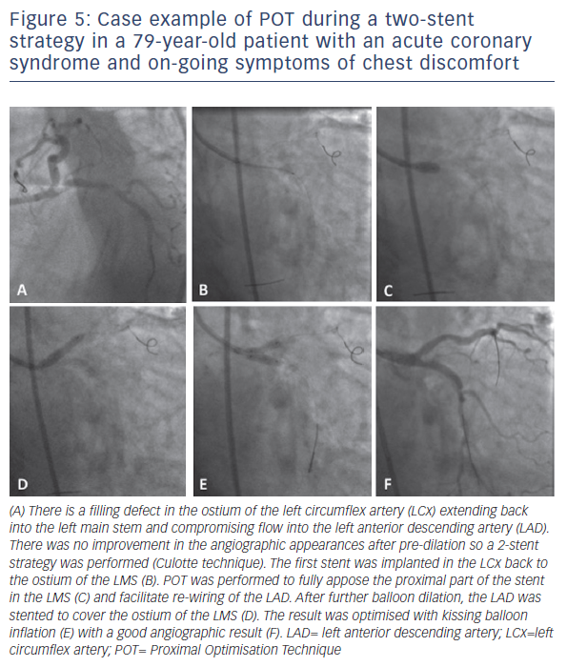
Hoye A
Figure 5: Case example of POT during a two-stent strategy in a 79-year-old patient with an acute coronary syndrome and on-going symptoms of chest discomfort
Citation: Interventional Cardiology Review 2017;12(2):110–5.
https://doi.org/10.15420/icr.2017:11:2

