Slide 1
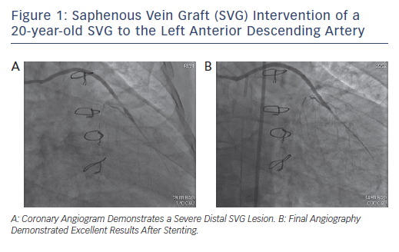
Lee M, Kong J
Figure 1: Saphenous Vein Graft (SVG) Intervention of a&lt;br /&gt;&#10;20-year-old SVG to the Left Anterior Descending Artery
Citation: Interventional Cardiology Review 2017;12(2):85–91.
https://doi.org/10.15420/icr.2017:4:2

