Slide 1
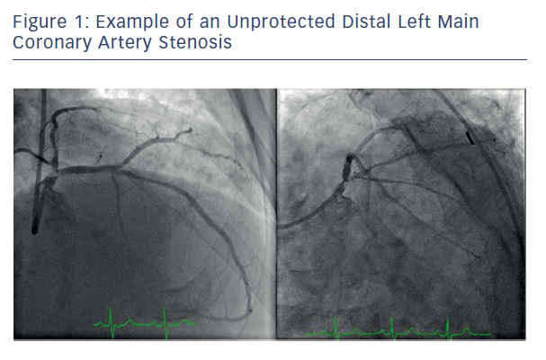
Kapadia SR, Ellis SG, Borges N
Figure 1: Example of an Unprotected Distal Left Main&lt;br /&gt;&#10;Coronary Artery Stenosis
Citation: Interventional Cardiology Review 2017;12(2):92–6.
https://doi.org/10.15420/icr.2017:18:2

