Slide 1
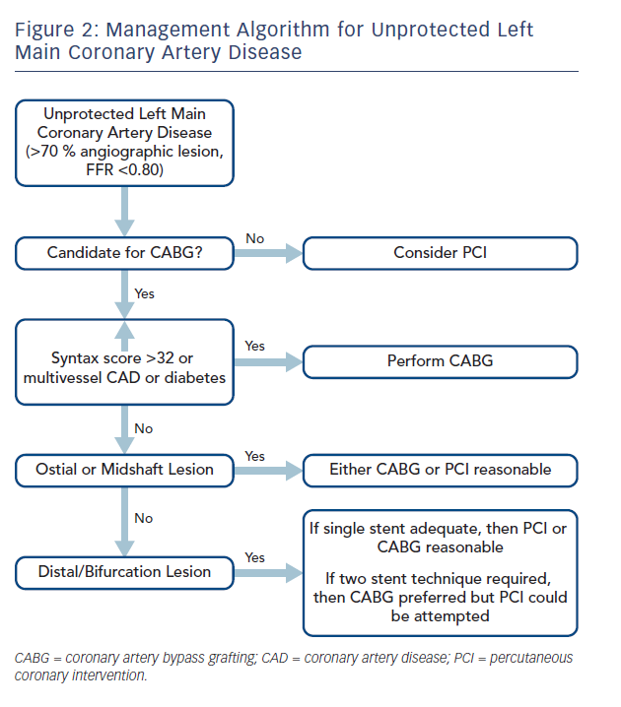
Kapadia SR, Ellis SG, Borges N
Figure 2: Management Algorithm for Unprotected Left&lt;br /&gt;&#10;Main Coronary Artery Disease
Citation: Interventional Cardiology Review 2017;12(2):92–6.
https://doi.org/10.15420/icr.2017:18:2

