Slide 1
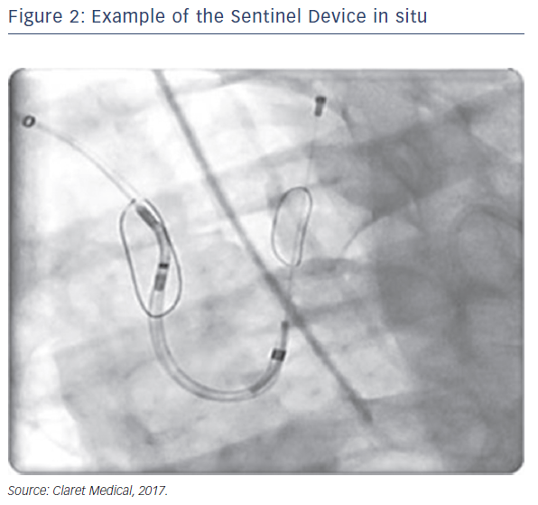
Schäfer U
Safety and Efficacy of Protected Cardiac Intervention: Clinical Evidence for Sentinel Cerebral Embolic Protection
Citation: Interventional Cardiology Review 2017;12(2):128–32.
https://doi.org/10.15420/icr.2017:19:2

