Slide 1

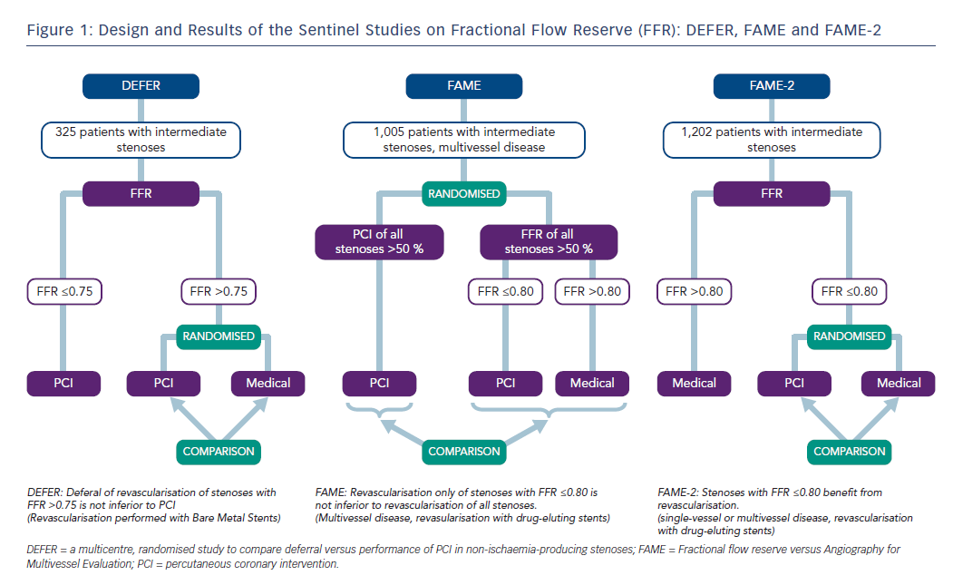
Achenbach S, Rudolph T, Rieber J, Eggebrecht H, Richardt G, Schmitz T, Werner N, Boenner F, Möllmann H
Figure 1: Design and Results of the Sentinel Studies on Fractional Flow Reserve (FFR): DEFER, FAME and FAME-2
Citation: Interventional Cardiology Review 2017;12(2):97–109
https://doi.org/10.15420/icr.2017:13:2

