Slide 1
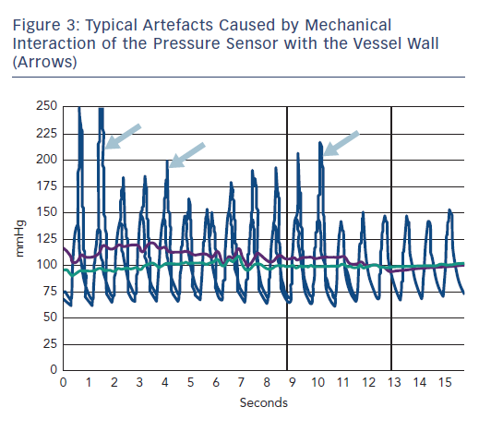
Achenbach S, Rudolph T, Rieber J, Eggebrecht H, Richardt G, Schmitz T, Werner N, Boenner F, Möllmann H
Figure 3: Typical Artefacts Caused by Mechanical&lt;br /&gt;&#10;Interaction of the Pressure Sensor with the Vessel Wall&lt;br /&gt;&#10;(Arrows)
Citation: Interventional Cardiology Review 2017;12(2):97–109
https://doi.org/10.15420/icr.2017:13:2

