Slide 1
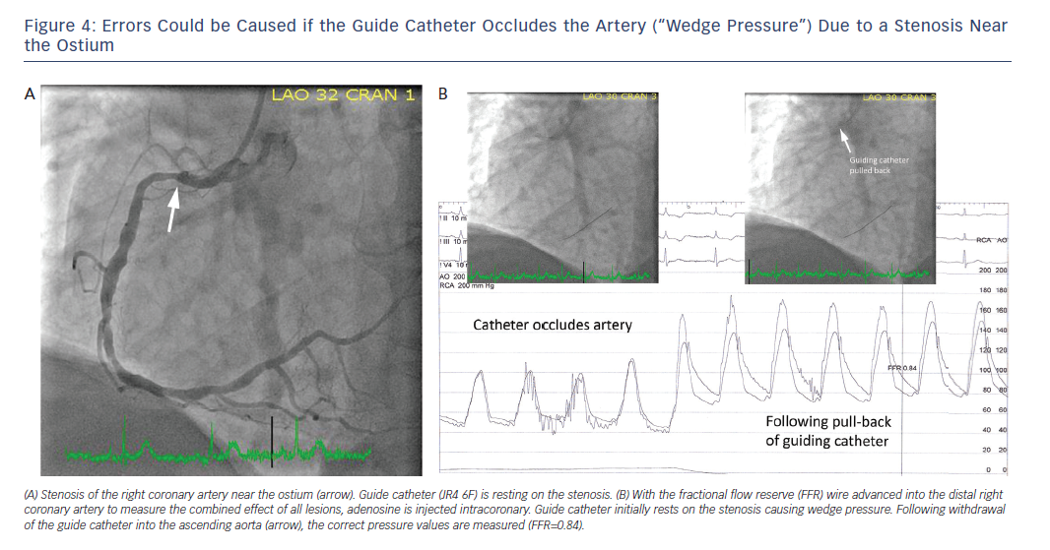
Achenbach S, Rudolph T, Rieber J, Eggebrecht H, Richardt G, Schmitz T, Werner N, Boenner F, Möllmann H
Figure 4: Errors Could be Caused if the Guide Catheter Occludes the Artery (“Wedge Pressure”) Due to a Stenosis Near&lt;br /&gt;&#10;the Ostium
Citation: Interventional Cardiology Review 2017;12(2):97–109
https://doi.org/10.15420/icr.2017:13:2

