Slide 1

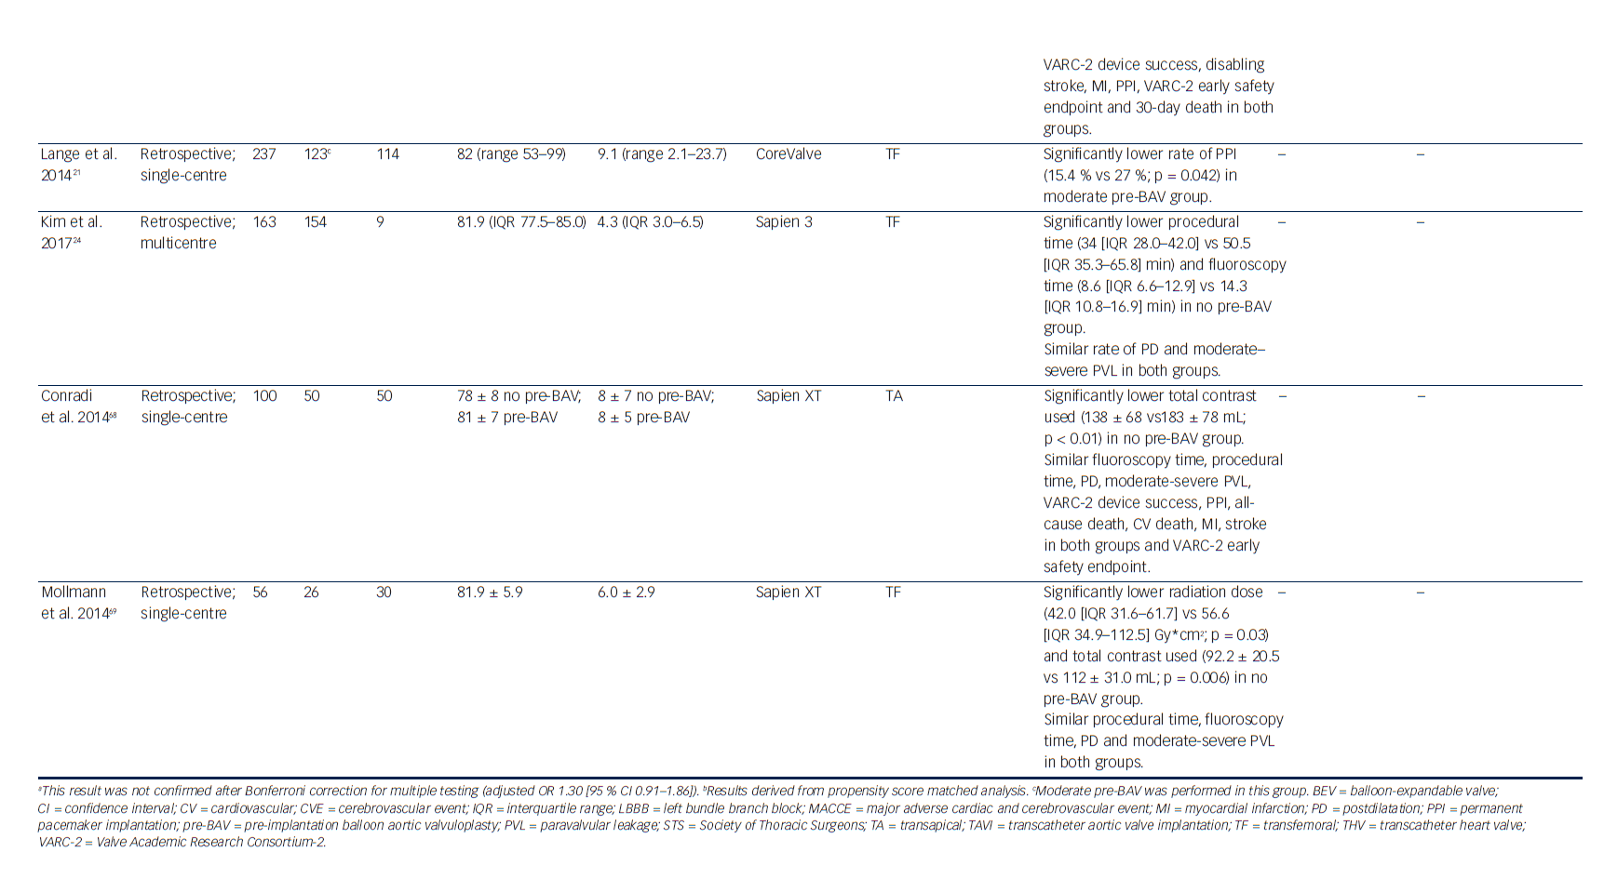
Pagnesi M, Baldetti L, Del Sole P, Mangieri A, Ancona MB, Regazzoli D, Buzzatti N, Giannini F, Colombo A, Latib A
Table 1: Studies Comparing the Outcomes of Patients Undergoing TAVI With and Without Predilatation
Citation: Interventional Cardiology Review 2017;12(2):116–25.
https://doi.org/10.15420/icr.2017:17:2

