Slide 1
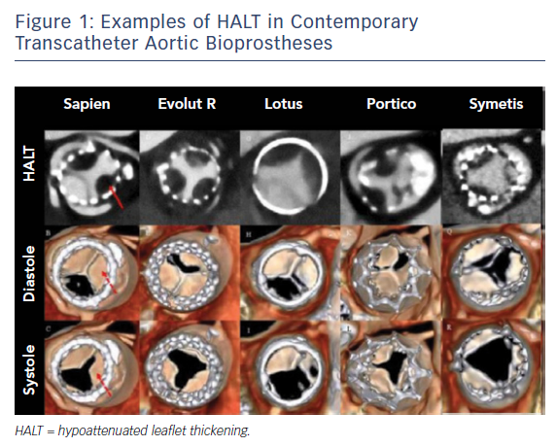
Testa L, Latib A
Assessing the Risk of Leaflet Motion Abnormality Following Transcatheter Aortic Valve Implantation
Citation: Interventional Cardiology Review 2018;13(1):37–9.
https://doi.org/10.15420/icr.2017:24:2

