Slide 1
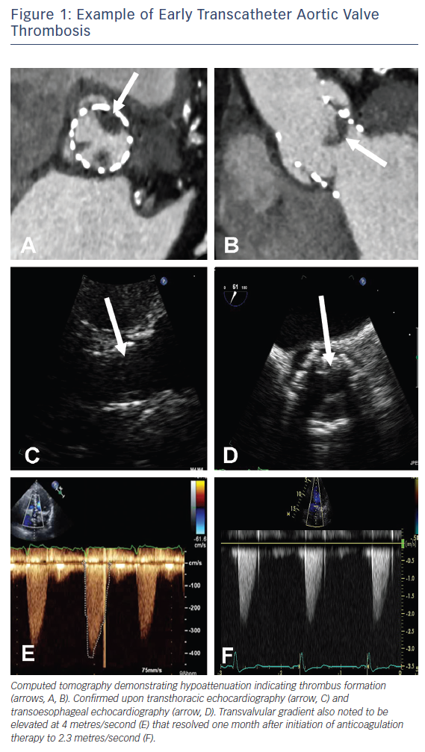
Ruparelia N
Figure 1: Example of Early Transcatheter Aortic Valve Thrombosis
Citation: Interventional Cardiology Review 2018;13(1):33–6.
https://doi.org/10.15420/icr.2017:14:1

