Slide 1
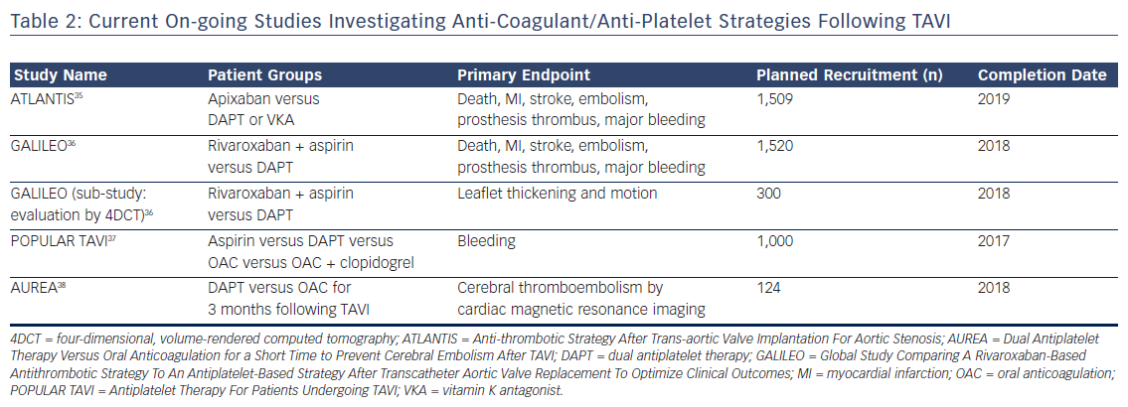
Ruparelia N
Table 2: Current On-going Studies Investigating Anti-Coagulant/Anti-Platelet Strategies Following TAVI
Citation: Interventional Cardiology Review 2018;13(1):33–6.
https://doi.org/10.15420/icr.2017:14:1

