Slide 1
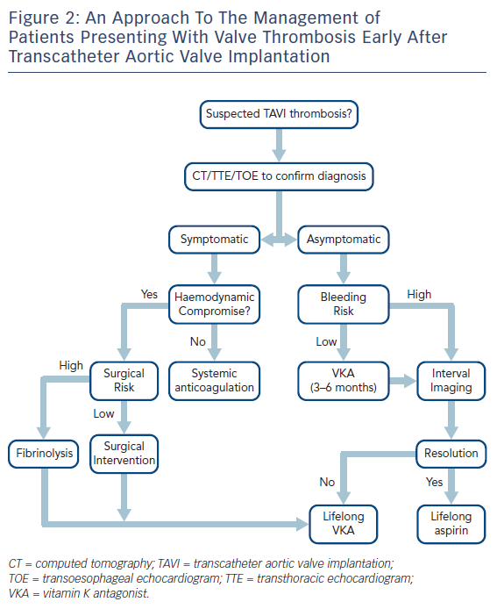
Ruparelia N
Figure 2: An Approach To The Management of Patients Presenting With Valve Thrombosis Early After Transcatheter Aortic Valve Implantation
Citation: Interventional Cardiology Review 2018;13(1):33–6.
https://doi.org/10.15420/icr.2017:14:1

