Slide 1
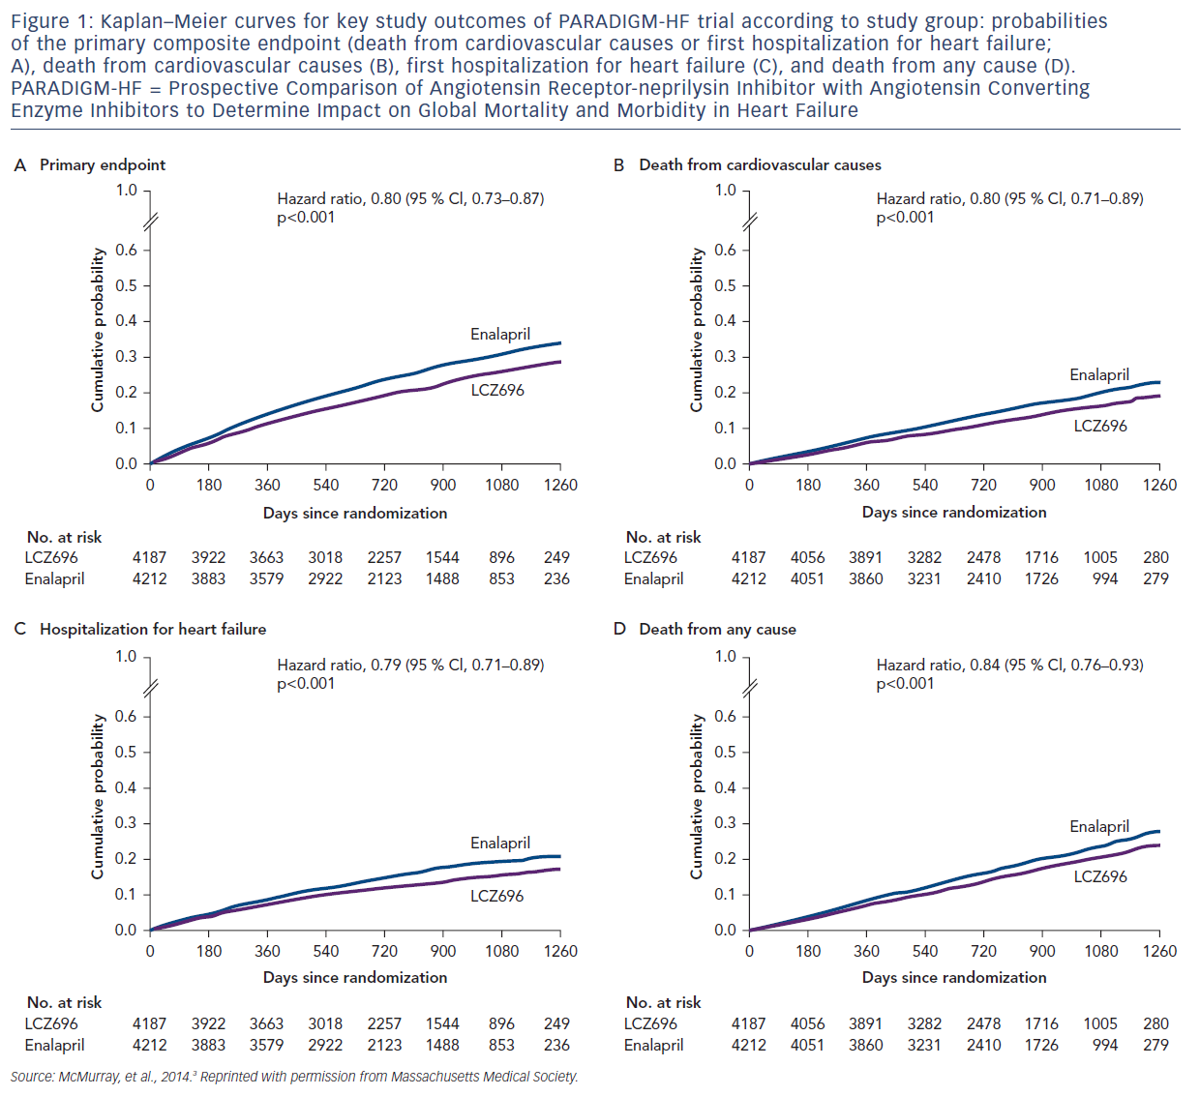
Bindra A, Hall SA
Figure 1: Kaplan–Meier curves for key study outcomes of PARADIGM-HF trial according to study group
Citation: US Cardiology Review 2017;11(2):62–6.
https://doi.org/10.15420/usc.2017:17:1

