Slide 1
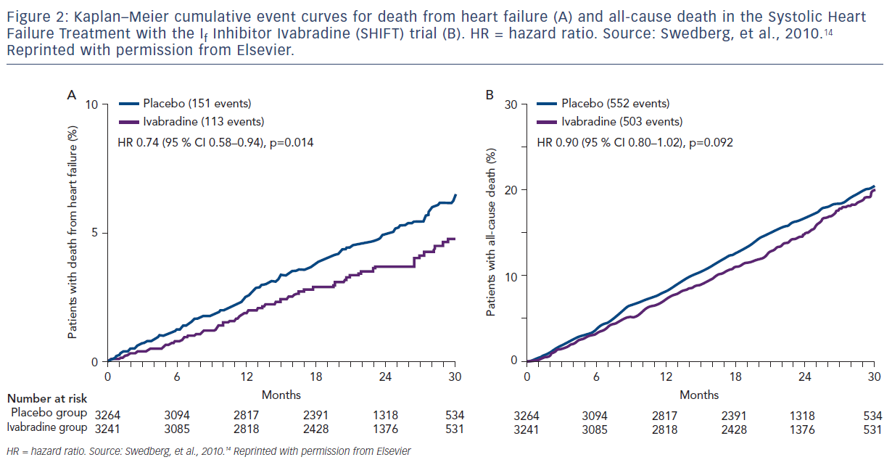
Bindra A, Hall SA
Figure 2: Kaplan–Meier cumulative event curves for death from heart failure (A) and all-cause death in the Systolic Heart Failure
Citation: US Cardiology Review 2017;11(2):62–6.
https://doi.org/10.15420/usc.2017:17:1

