Slide 1
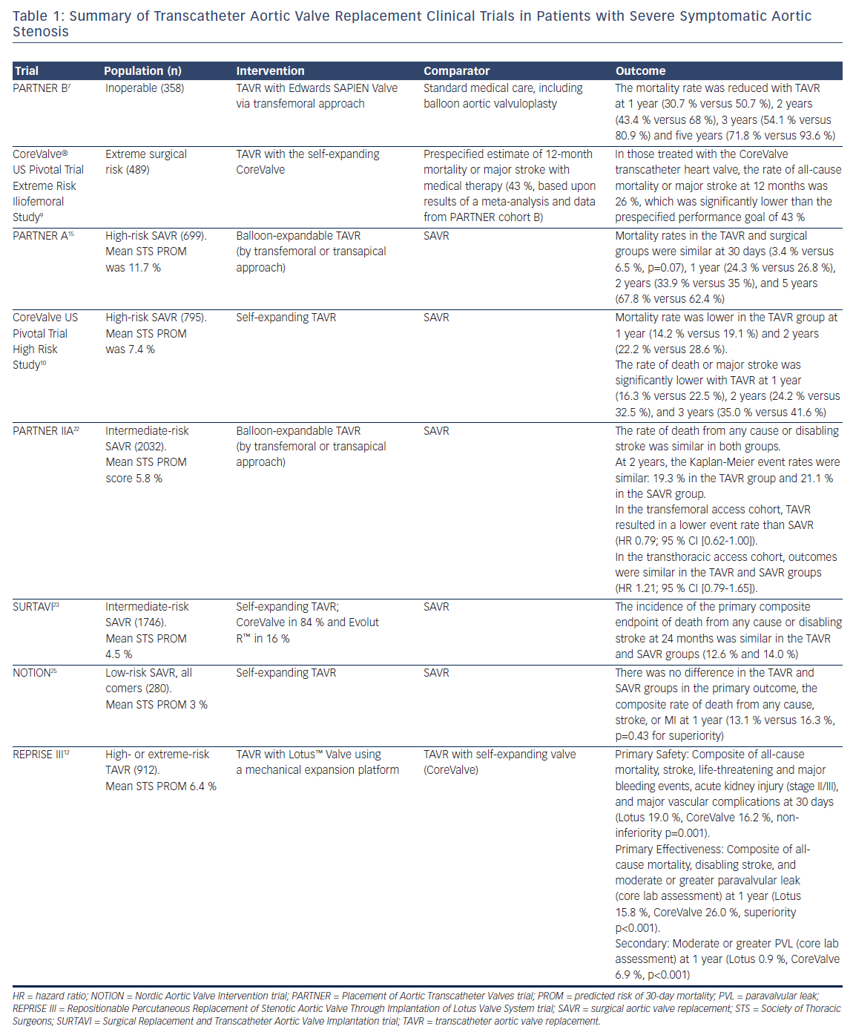
Barker CM, Reardon MJ
Clinical Practice Update: Who Should Be Referred for Transcatheter Aortic Valve Replacement in 2017?
Citation: US Cardiology Review 2017;11(2):67–71.
https://doi.org/10.15420/usc.2017:22:1

