Slide 1
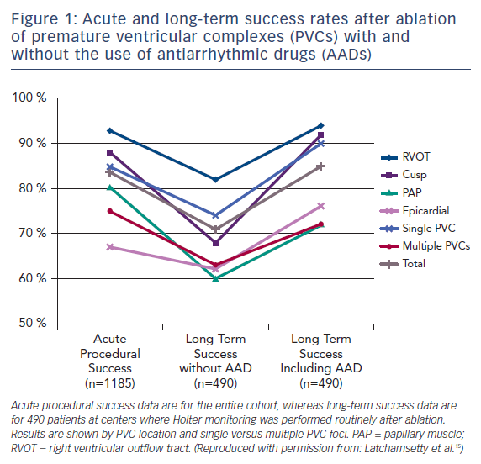
Latchamsetty R
Figure 1: Acute and long-term success rates after ablation of premature ventricular complexes
Citation: US Cardiology Review 2017;11(2):95–7.
https://doi.org/10.15420/usc.2017:19:1

