Slide 1
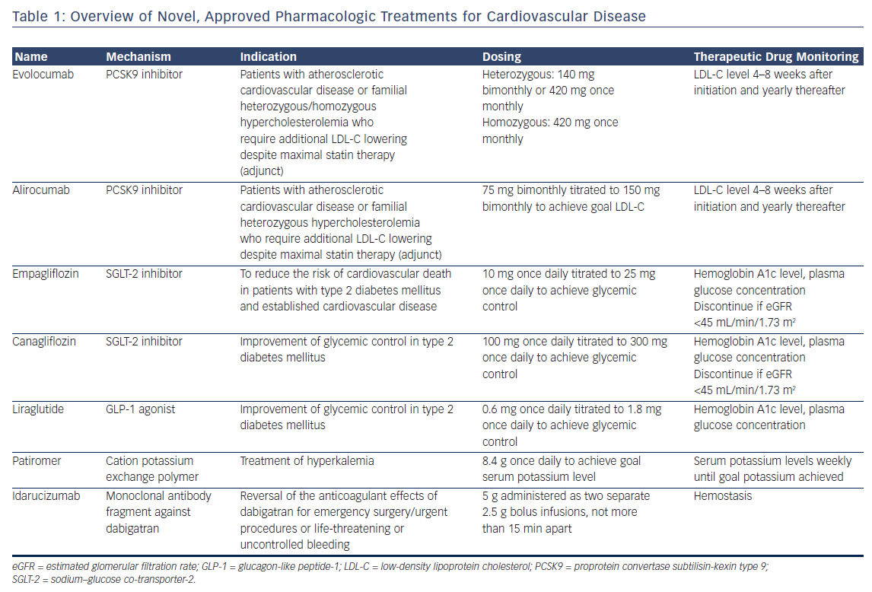
Buckley L, Aldemerdash A
Table 1: Overview of Novel, Approved Pharmacologic Treatments for Cardiovascular Disease
Citation: US Cardiology Review 2017;11(2):98–104.
https://doi.org/10.15420/usc.2017:20:2

