Slide 1
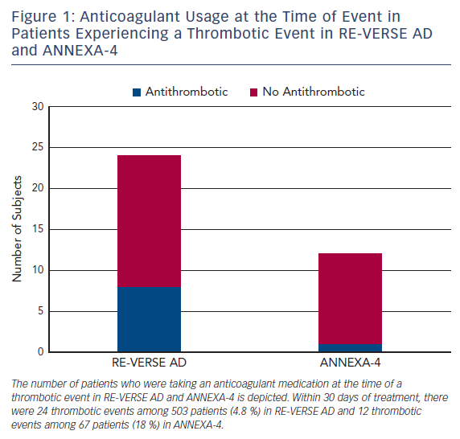
Buckley L, Aldemerdash A
Figure 1: Anticoagulant Usage at the Time of Event in Patients Experiencing a Thrombotic Event in RE-VERSE AD and ANNEXA-4
Citation: US Cardiology Review 2017;11(2):98–104.
https://doi.org/10.15420/usc.2017:20:2

