Slide 1
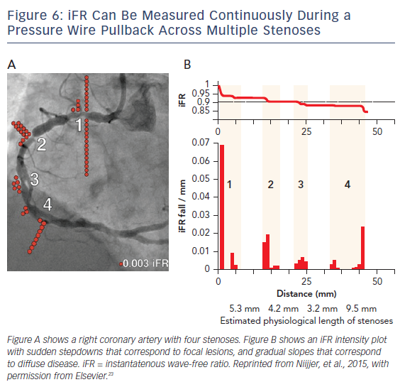
Kern MJ, Yu KM
Figure 6: IFR Can Be Measured Continuously During A Pressure Wire Pullback Across Multiple Stenoses
Citation: US Cardiology Review 2017;11(2):80–5.
https://doi.org/10.15420/usc.2017:13:1

