Slide 1
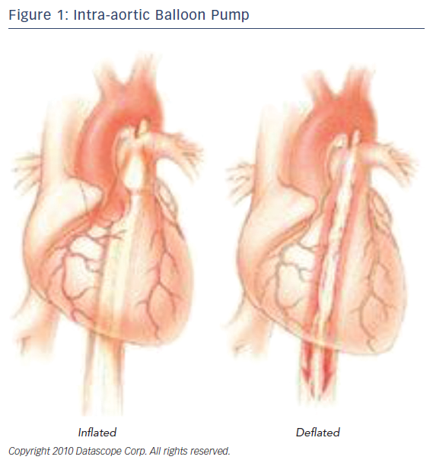
Alabbady AM, Abdul-Al AS, Skelding KA
Figure 1: Intra-aortic Balloon Pump
Citation: US Cardiology Review 2017;11(2):86–94.
https://doi.org/10.15420/usc.2017:14:2

