Slide 1
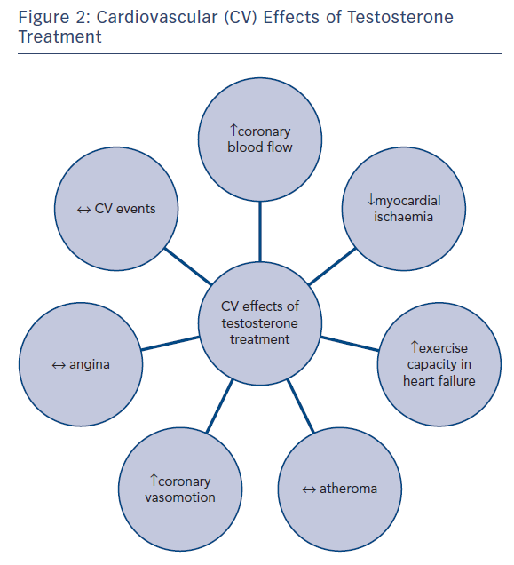
Webb CM, Collins P
Figure 2: Cardiovascular (CV) Effects of Testosterone Treatment
Citation: European Cardiology Review 2017;12(2):83–7
https://doi.org/10.15420/ecr.2017:21:1

