Slide 1
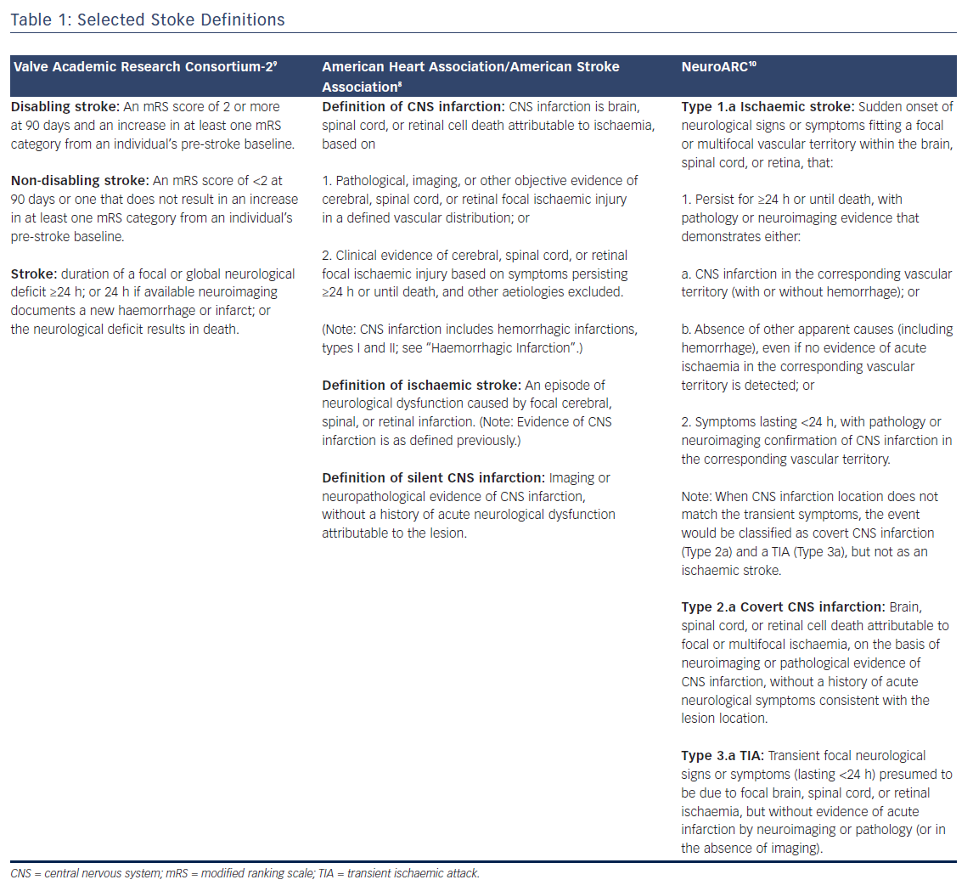
Ghare MI, Lansky A
Table 1: Selected Stoke Definitions
Citation: Interventional Cardiology Review 2018;13(1):27–32.
https://doi.org/10.15420/icr.2017:25:1

