Slide 1
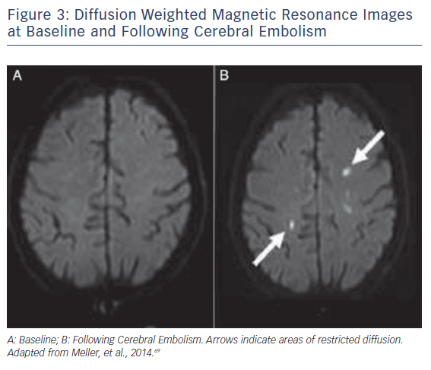
Ghare MI, Lansky A
Figure 3: Diffusion Weighted Magnetic Resonance Images at Baseline and Following Cerebral Embolism
Citation: Interventional Cardiology Review 2018;13(1):27–32.
https://doi.org/10.15420/icr.2017:25:1

