Slide 1
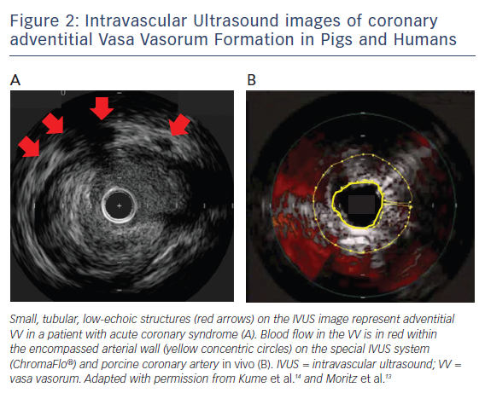
Nishimiya K, Matsumoto Y, Shimokawa H
Figure 2: Intravascular Ultrasound images of coronary adventitial Vasa Vasorum Formation in Pigs and Humans
Citation: European Cardiology Review 2017;12(2):121–3
https://doi.org/10.15420/ecr.2017:13:1

