Slide 1
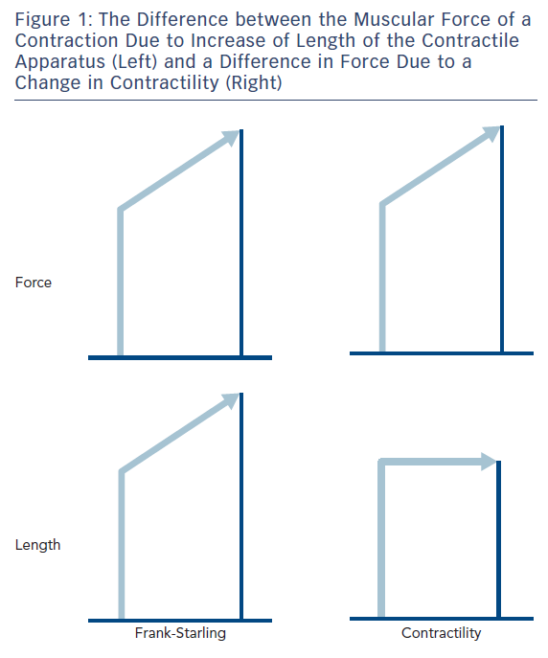
Noble MI
Figure 1: The Difference between the Muscular Force of a Contraction Due to Increase of Length of the Contractile Apparatus (Left) and a Difference in Force Due to a Change in Contractility (Right)
Citation: Cardiac Failure Review 2017;3(2):79–82.
https://doi.org/10.15420/cfr.2017:17:1

