Slide 1
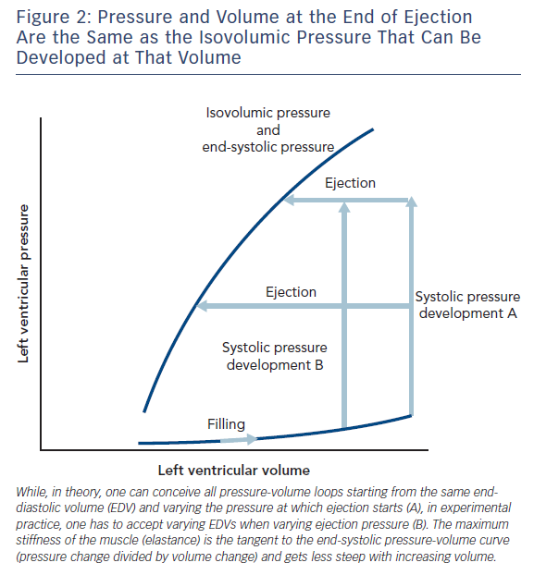
Noble MI
Figure 2: Pressure and Volume at the End of Ejection Are the Same as the Isovolumic Pressure That Can Be Developed at That Volume
Citation: Cardiac Failure Review 2017;3(2):79–82.
https://doi.org/10.15420/cfr.2017:17:1

