Slide 1
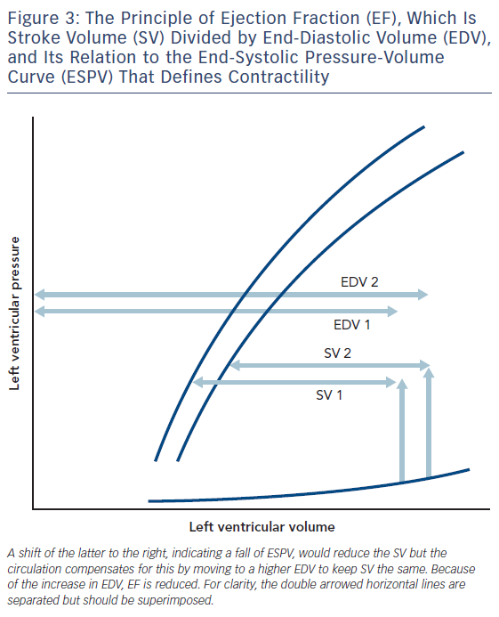
Noble MI
Figure 3: The Principle of Ejection Fraction (EF), Which Is Stroke Volume (SV) Divided by End-Diastolic Volume (EDV), and Its Relation to the End-Systolic Pressure-Volume Curve (ESPV) That Defines Contractility
Citation: Cardiac Failure Review 2017;3(2):79–82.
https://doi.org/10.15420/cfr.2017:17:1

