Slide 1
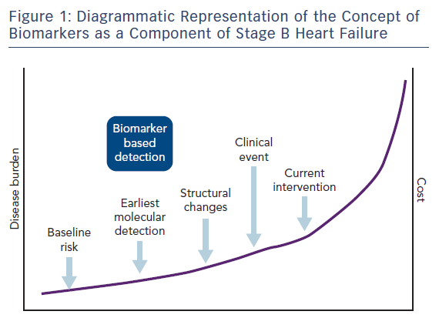
Gallagher J, Watson C, Campbell P, Ledwidge M, McDonald K
Figure 1: Diagrammatic Representation of the Concept of Biomarkers as a Component of Stage B Heart Failure
Citation: Cardiac Failure Review 2017;3(2):83–5.
https://doi.org/10.15420/cfr.2017:20:1

