Slide 1
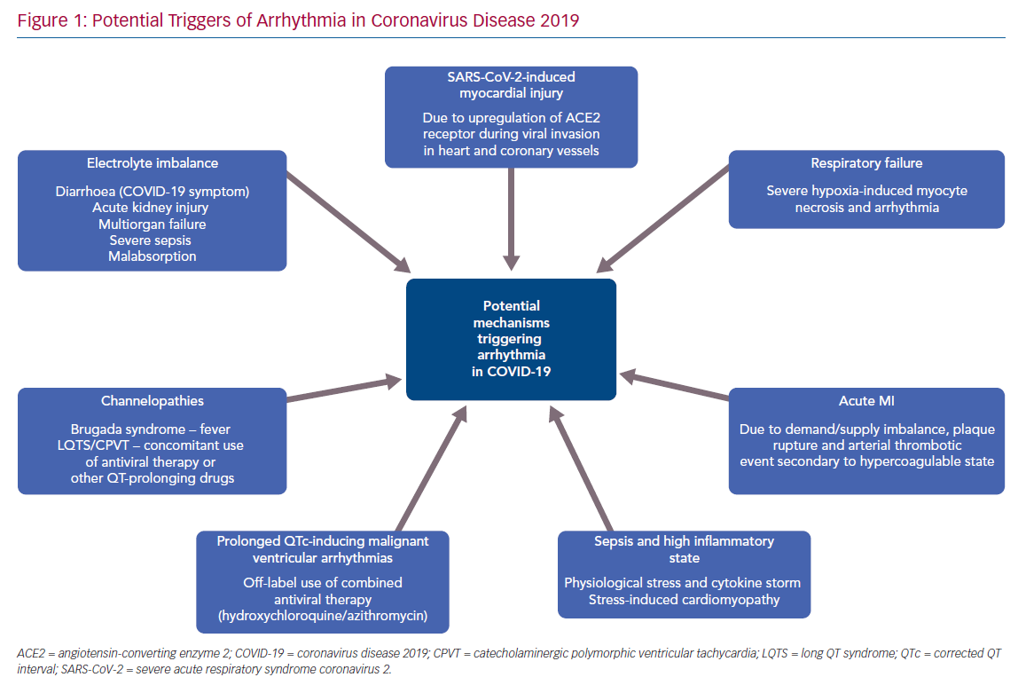
Lessons Learned From RADIOSOUND-HTN: Different Technologies And Techniques For Catheter-Based Renal Denervation And Their Effect On Blood Pressure
Citation: Interventional Cardiology Review 2019;14(2):102–6
https://doi.org/10.15420/icr.2019.03.R1

