Slide 1
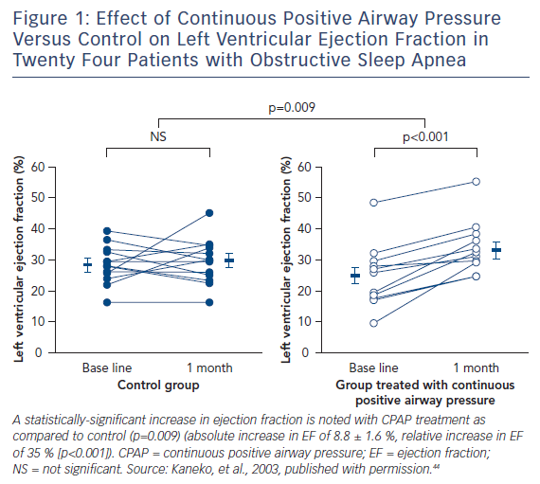
Valika A, Costanzo MR
Sleep-Disordered Breathing During Congestive Heart Failure: To Intervene or Not to Intervene?
Citation: Cardiac Failure Review 2017;3(2):134–9
https://doi.org/10.15420/cfr.2017:7:1

