Slide 1
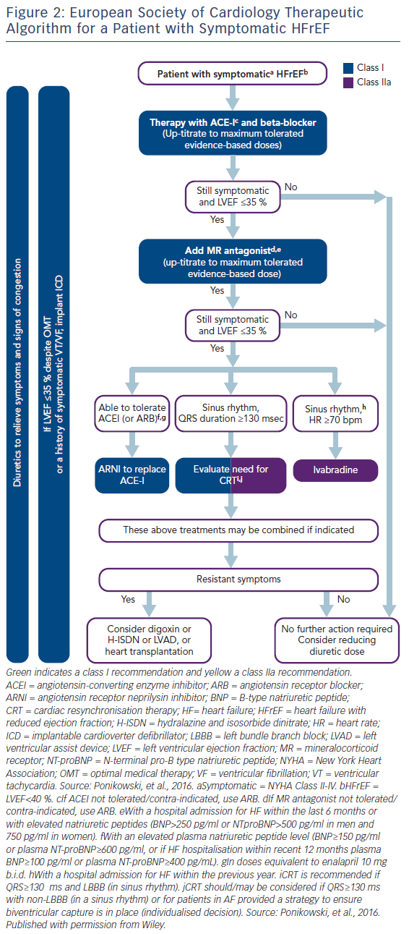
Cowie MR, Komajda M
Figure 2: European Society of Cardiology Therapeutic Algorithm for a Patient with Symptomatic HFrEF
Citation: Cardiac Failure Review 2017;3(2):130–3.
https://doi.org/10.15420/cfr.2017:13:1

