Slide 1
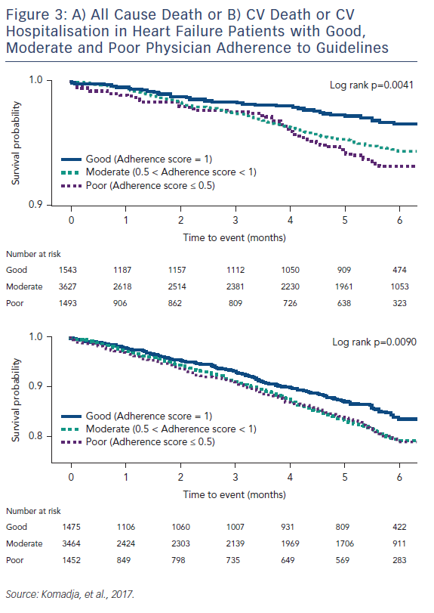
Cowie MR, Komajda M
Figure 3: A) All Cause Death or B) CV Death or CV Hospitalisation in Heart Failure Patients with Good, Moderate and Poor Physician Adherence to Guidelines
Citation: Cardiac Failure Review 2017;3(2):130–3.
https://doi.org/10.15420/cfr.2017:13:1

