Slide 1
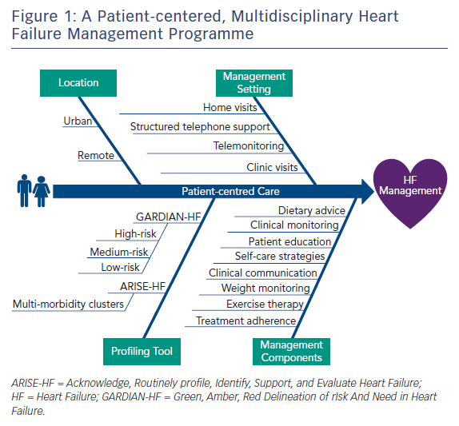
Chan YK, David AM, Mainland C, Chen L, Stewart S
Figure 1: A Patient-centered, Multidisciplinary Heart Failure Management Programme
Citation: Cardiac Failure Review 2017;3(2):113–5.
https://doi.org/10.15420/cfr.2017:11:1

