Slide 1
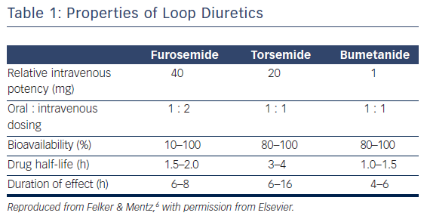
Pham D, Grodin JL
Table 1: Properties of Loop Diuretics
Citation: Cardiac Failure Review 2017;3(2):108–12.
https://doi.org/10.15420/cfr.2017:10:1

