Slide 1
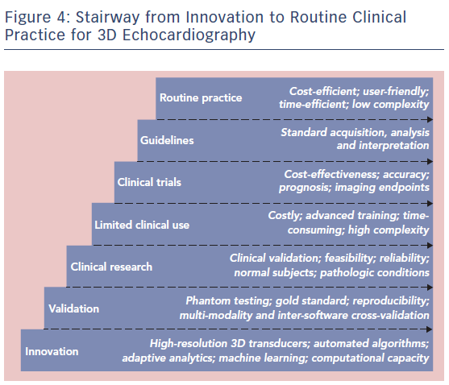
Spitzer E, Ren B, Zijlstra F, Van Mieghem NM, Geleijnse ML
Figure 4: Stairway from Innovation to Routine Clinical Practice for 3D Echocardiography
Citation: Cardiac Failure Review 2017;3(2):97–101.
https://doi.org/10.15420/cfr.2017:14.1

